Slide 1
Stroke Prediction A Machine Learning approach
Monirul Islam Mahmud – 2011839042
Hafeza Akter - 1922175042

Slide 2
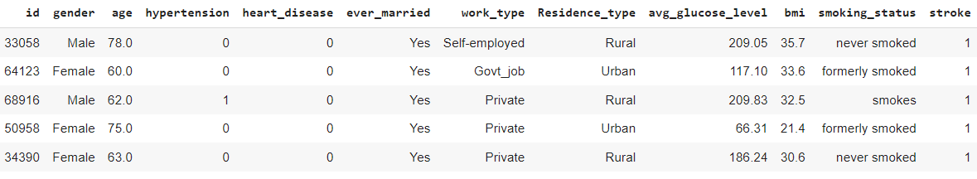
Dataset Info
(Public Dataset)
5395 unique data.
Combination of Kaggle & UCI
(Private Dataset)
15 unique data.
Collected from Hospital.
100 more yet to receive.

Slide 3
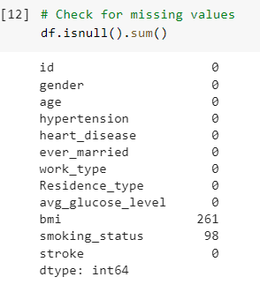
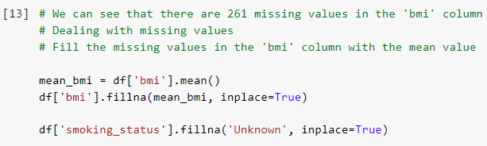
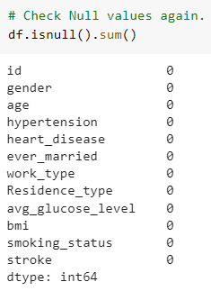

Missing Data Handle
We have filled the missing value with Mean Bmi value because as bmi increases it has a higher chance that it will be stroke patient. Then we also fill with ‘Unknown’ in smoking status null values.
We can see 261 & 98 Null Values in BMI and Smoking status.
There is no Null values after handling missing value.

Slide 4
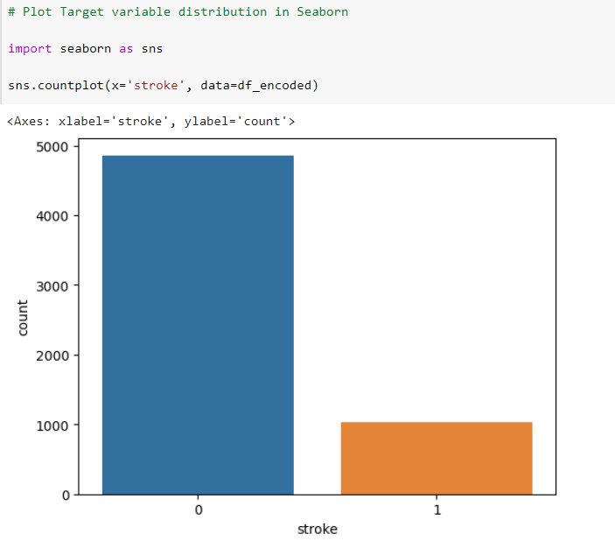
Target Variable distribution
Let's first take a look at the distribution of the target variable 'stroke’. We can see that the dataset is ‘highly imbalanced’ with only a small fraction of the samples having a stroke.

Slide 5
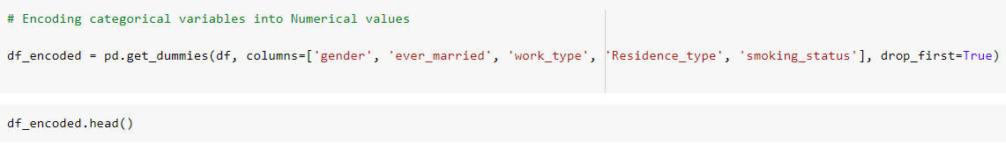
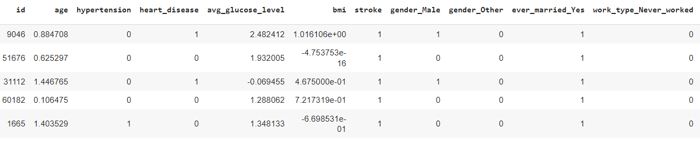
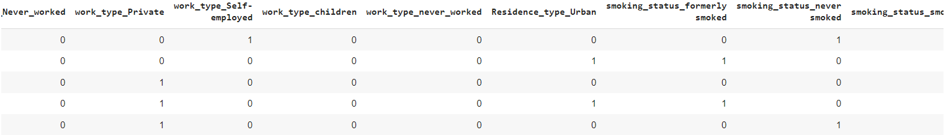
One Hot Encoding
We can use the pandas function get_dummies() to one-hot encode these categorical variables. We have used drop_first = True to avoid multicollinearity.

Slide 6
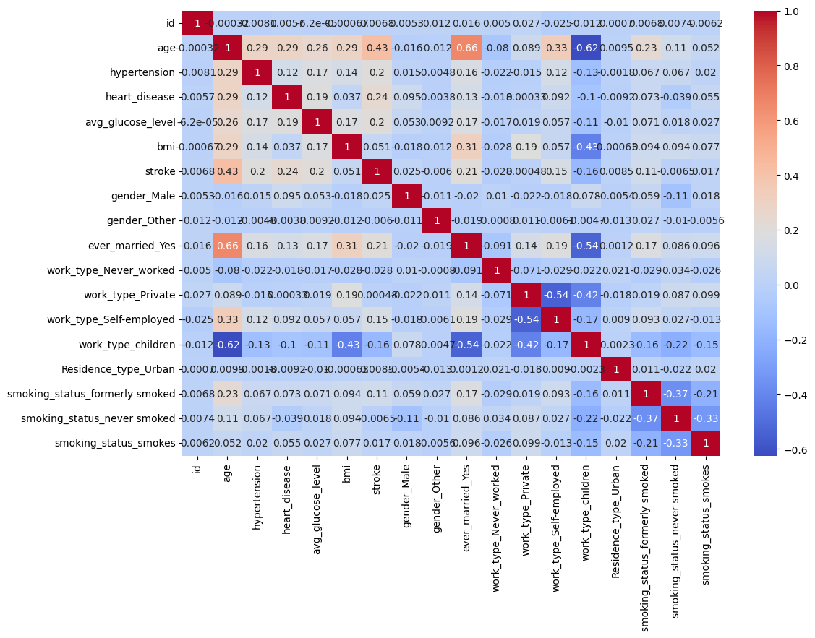
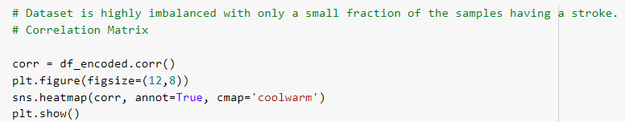
Correlation Matrix
Strong Positive Correlations: 'ever_married_Yes' and 'age’, age and stroke, age and smoking_status_formerly_smoked etc.
Strong Negative Correlations: age and work_type_children, bmi and work_type_children, gender_male and smoking_status_never_smoked etc.

Slide 7
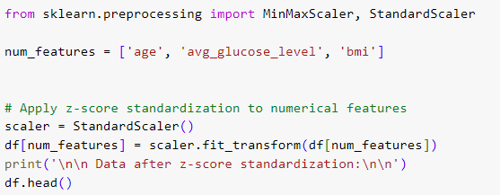
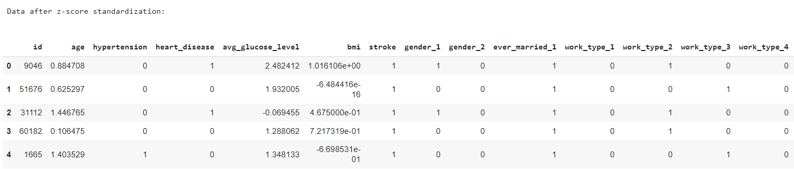
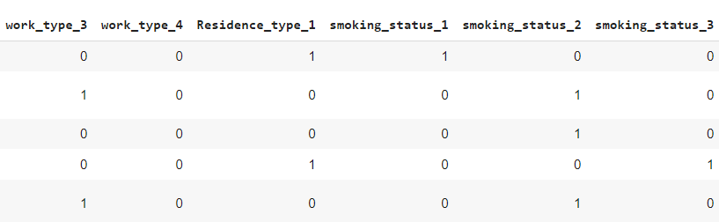
Standard Scaler
We need to scale the numerical variables 'age', 'avg_glucose_level', and 'bmi' so that they have similar scales. We can use the Standard Scaler function from the scikit-learn library to do this.

Slide 8
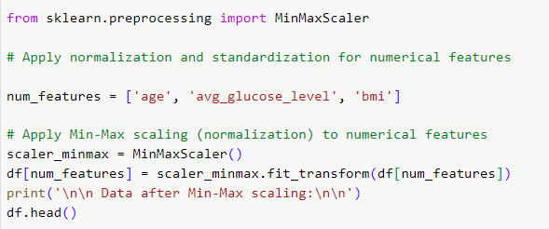
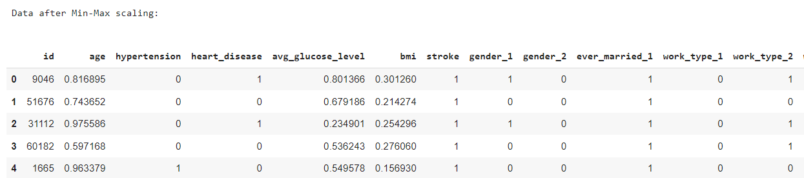
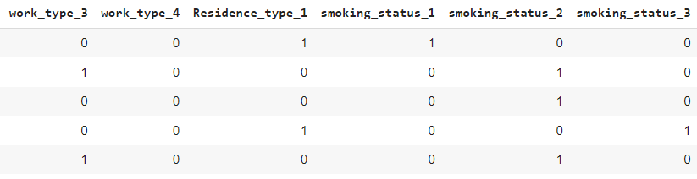
MinMax Scaler
We have also used Min Max Scaler from Scikit learn library to scale all the numerical features.

Slide 9
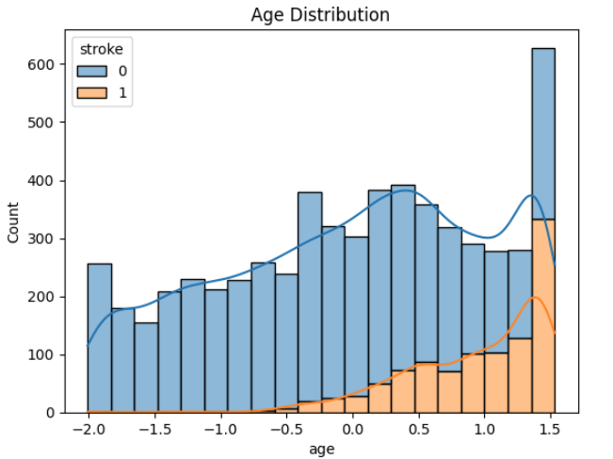
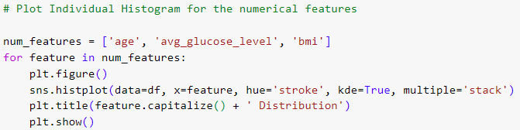
Histogram for the Numerical Features
We can see that the distribution of age is right-skewed and the number of strokes increases with age.
Observation

Slide 10
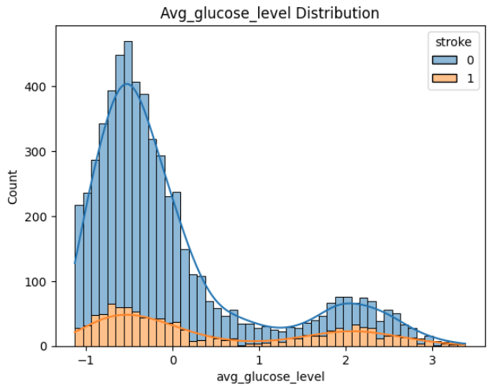
We can see that the distribution of glucose level is also right-skewed and there is a higher probability of stroke for people with higher glucose levels.
Observation

Slide 11
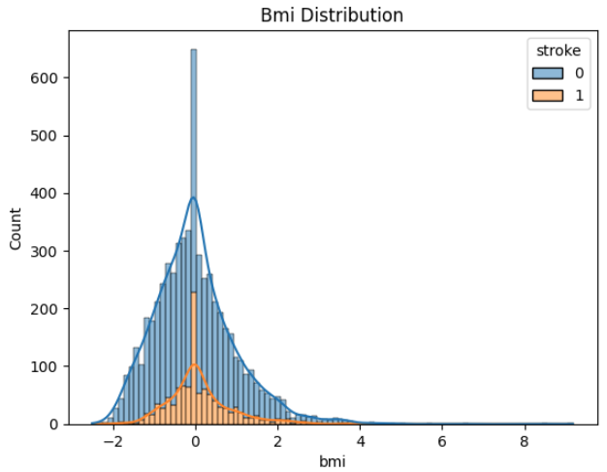
We can see that the distribution of BMI is almost normal and there is a higher probability of stroke for people with higher BMI.
Observation

Slide 12
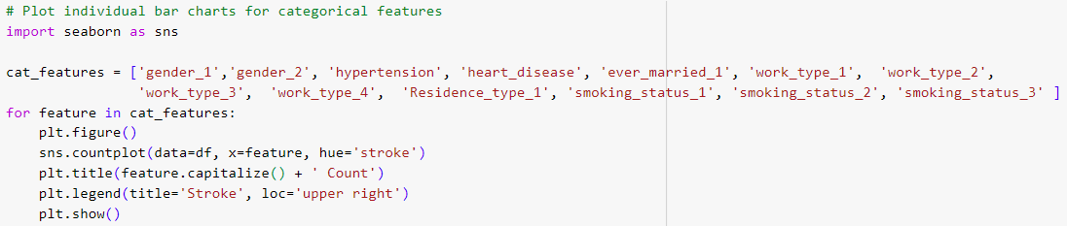
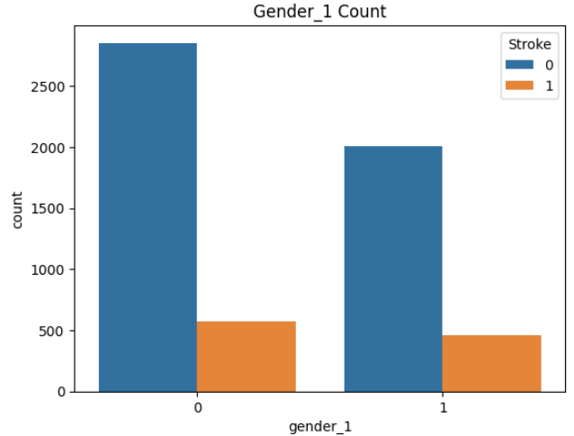
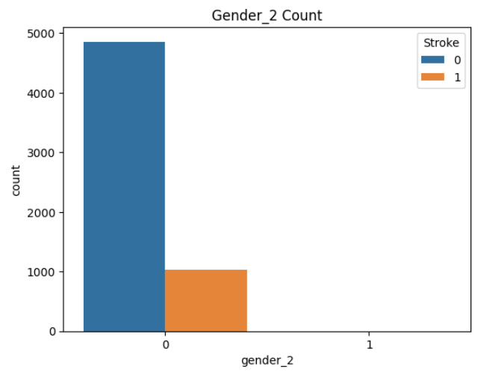
Bar Chart for Categorical Features
We can see, Male has higher chance of Stroke than Female gender.
Observation

Slide 13
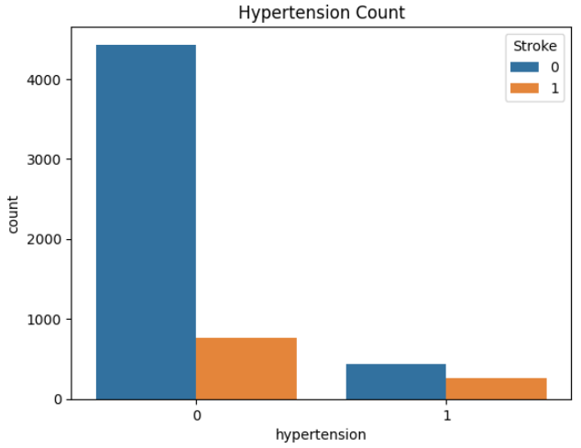
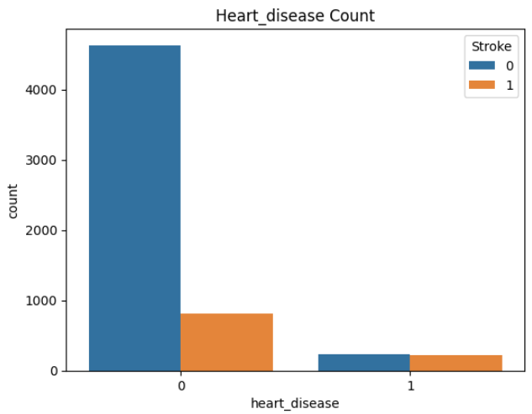
We can see, Hypertense person and person with Heart Disease has higher chances of Stroke.
Observation

Slide 14
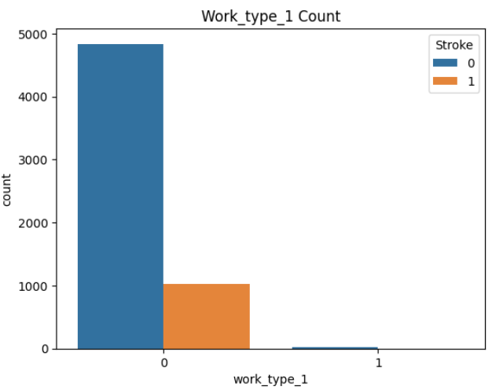
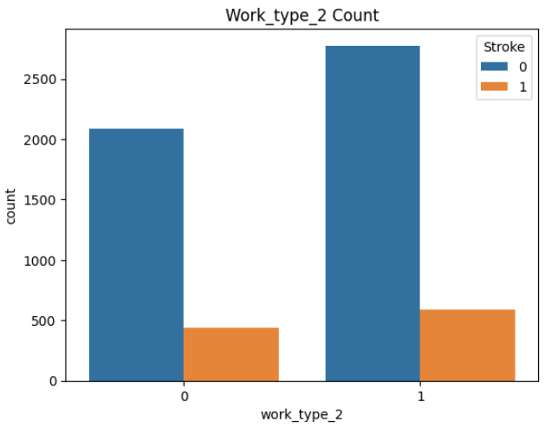
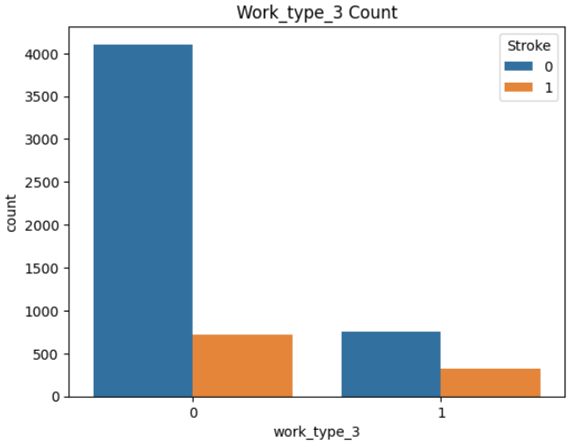
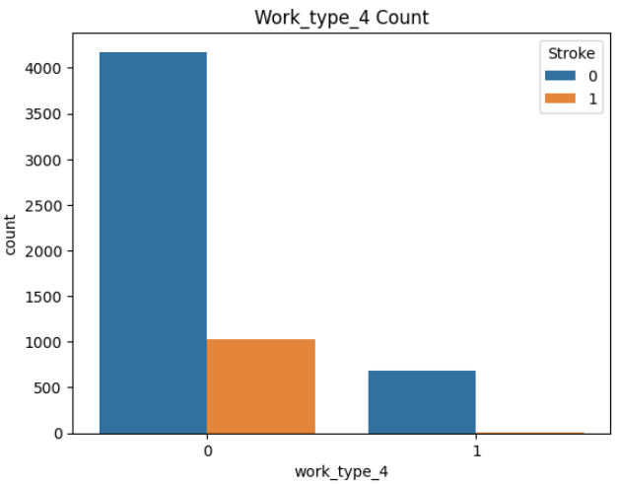
We can see, Work Type 2 (Private) and Work type 3 (Self Employed) have higher chances of having Stroke.
Observation

Slide 15
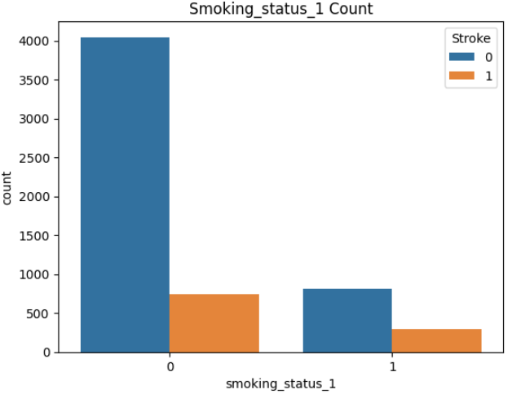
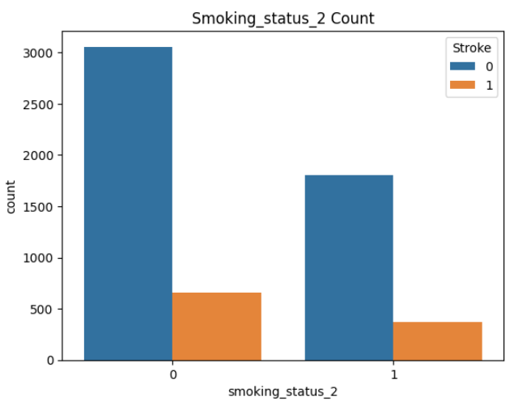
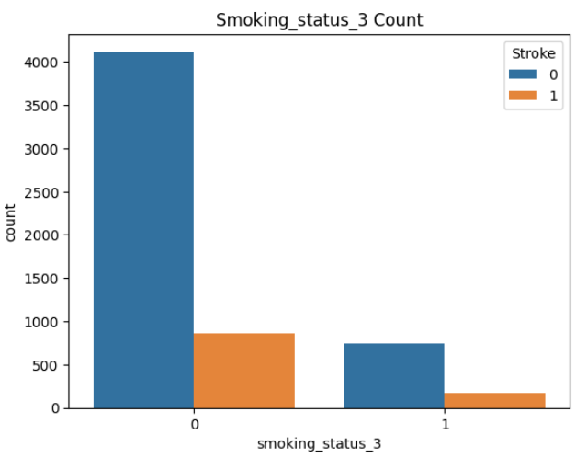
We can see, people with Smoking Status 1 (Formerly Smokes) and Smoking Status 3 (Smokes) have higher chances of stroke.
Observation

Slide 16
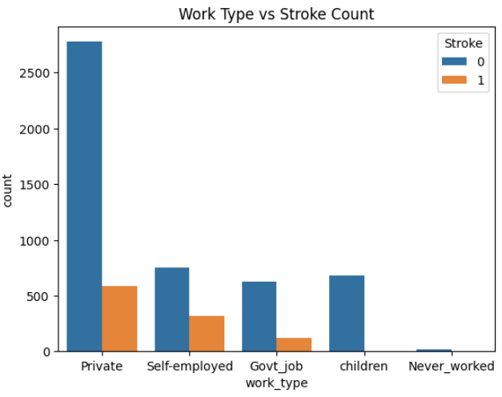
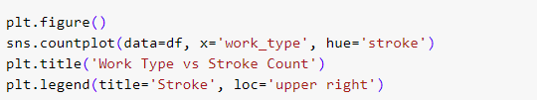
Bar plot for Categorical vs Categorical features
This graph displays a count of stroke occurrences for each work type category. The bars are grouped by stroke (having a stroke or not).
Observation

Slide 17
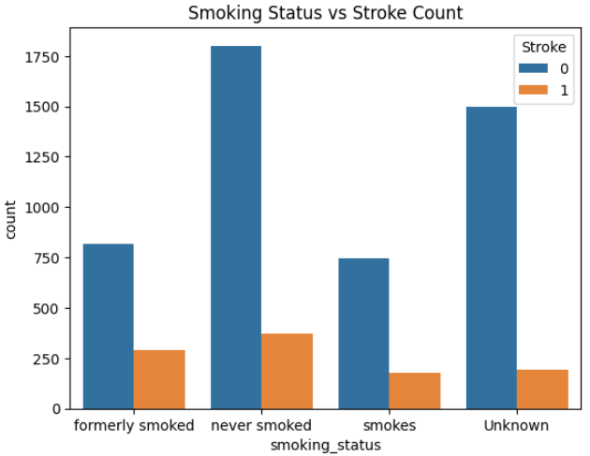

This graph shows the count of stroke occurrences for each smoking status category. The bars are grouped by stroke.
Observation

Slide 18
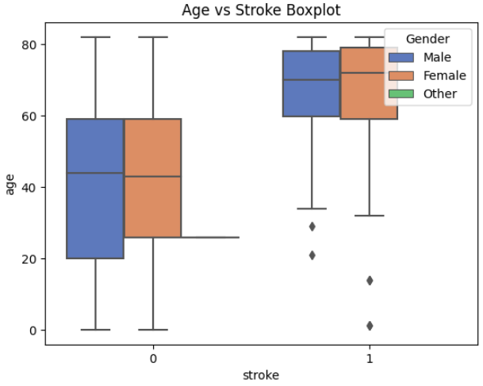
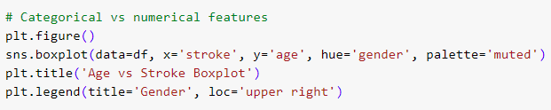
Box Plot for Categorical vs Numerical Features
This graph presents boxplots of age for each stroke category (having a stroke or not). The boxes represent the interquartile range (IQR) of age values, and the whiskers extend to the minimum and maximum values. The boxplots are further divided by gender using different colors.
Observation

Slide 19
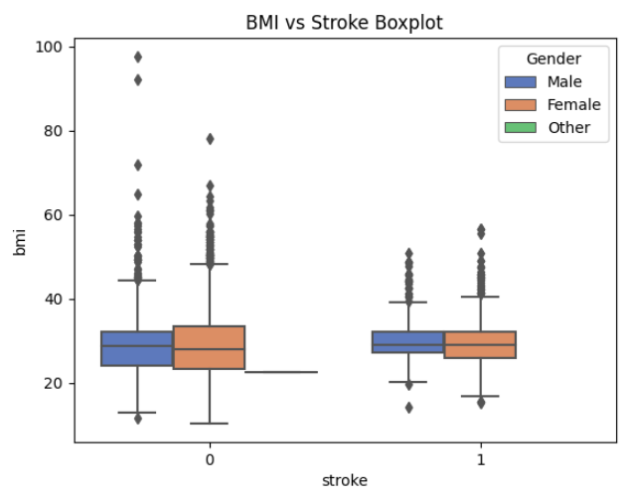

This graph displays boxplots of BMI (Body Mass Index) for each stroke category. Similar to the previous graph, the boxplots are divided by gender.
Observation

Slide 20
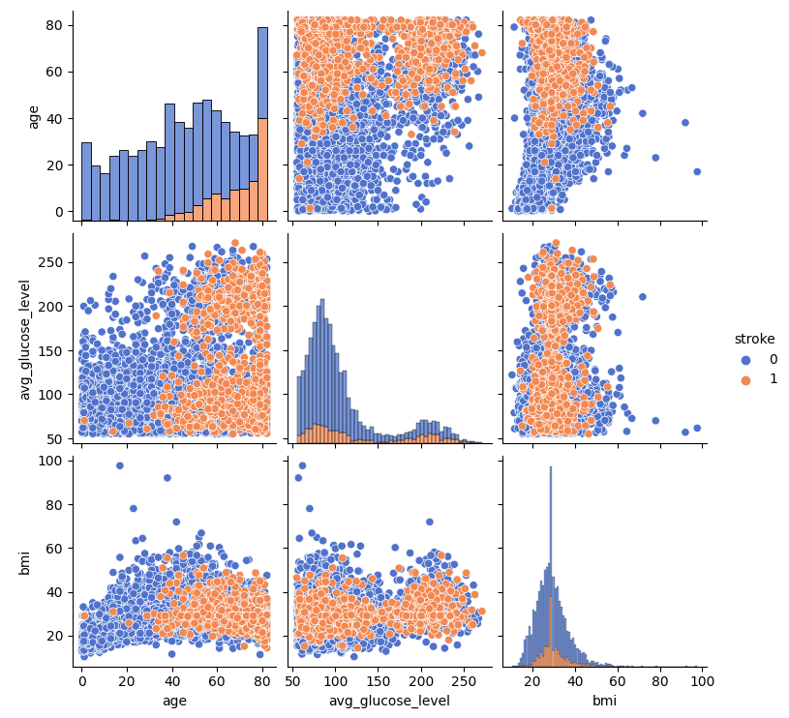
Pair Plot for Numerical vs Numerical Features
This graph is a pair plot that shows the relationships between numerical features: age, average glucose level, and BMI. Each scatter plot represents the relationship between two features, with the points colored by stroke category. The diagonal axes show histograms for each feature, stacked according to the stroke category.
Observation

Slide 21
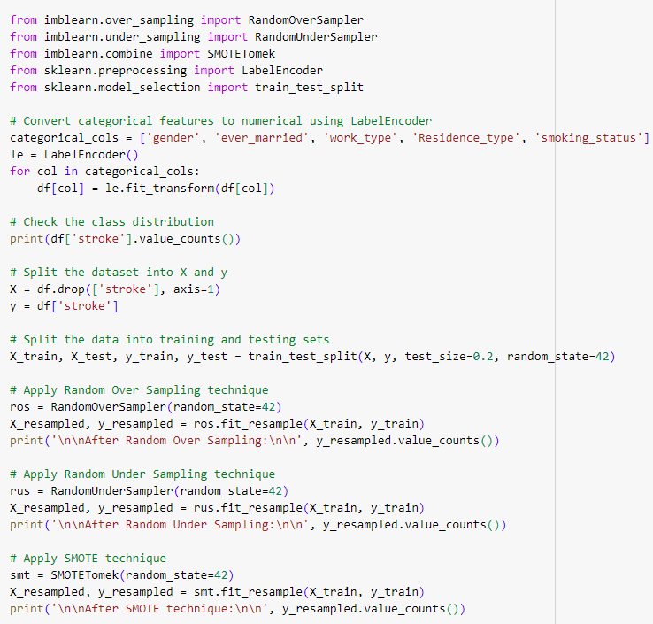
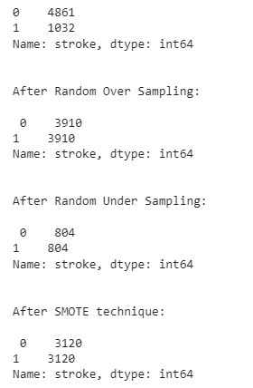
Balancing technique (SMOTE/ Oversampling / Undersampling)

Slide 22
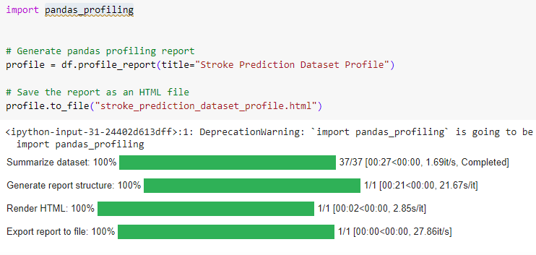
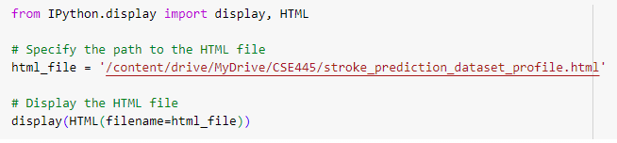
Pandas Profiling

Slide 23
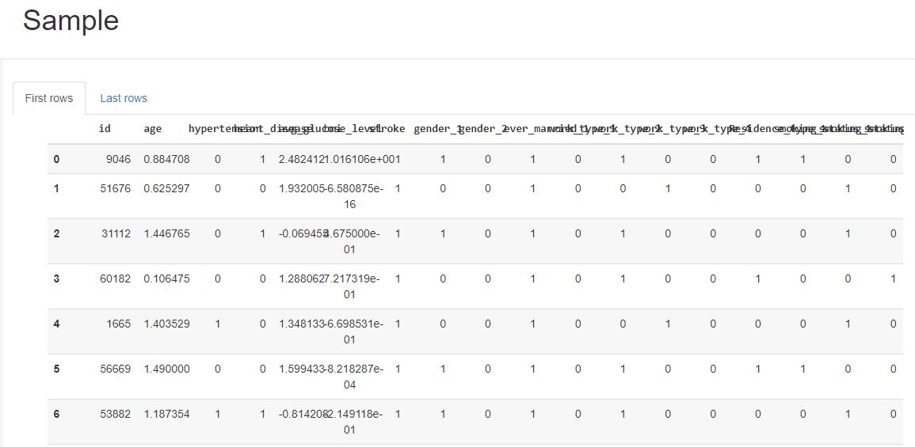
Pandas Report

Slide 24
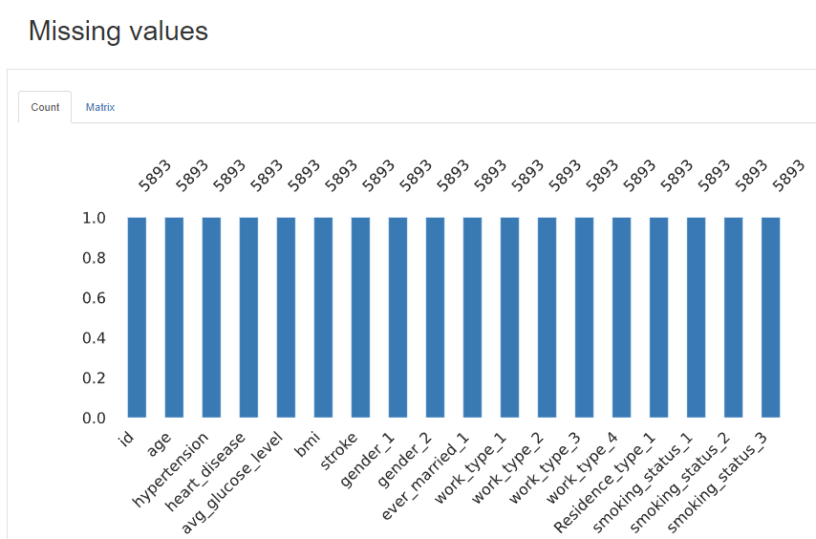
Pandas Report

Slide 25
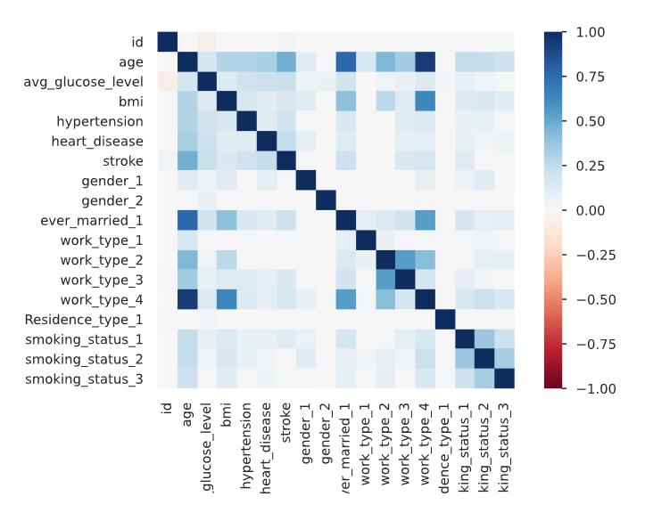
Pandas Report

Slide 26

Summary
In this EDA and data preprocessing, we have loaded and cleaned the Stroke prediction dataset.
We have also performed encoding and scaling of the features, and performed exploratory data analysis to understand the distribution of the features and the target variable.
We have found that the dataset is highly imbalanced and there are moderate correlations between some of the features and the target variable.
We have used Standardization, Resampling Techniques (Oversampling, Undersampling, SMOTE) in this EDA for balancing Data. We will also add more Stroke Patient data.

Slide 27
Thank You!

